Slide 1
Mid-term report
Experiments of the deep learning methods for the classification problem
Presenter:
Hoàng Cao Huyền – v.huyenhoang@vinbrain.net
Mentors:
Dương Thị Minh Soan – v.soanduong@vinbrain.net
Tạ Đức Huy – v.huyta@vinbrain.net

Slide 2
Training Pipeline
Dataset
Model
Loss, Metric, Optimizer
Experiments
Notes:
Số lượng class – distribution -

Slide 3
Training pipleline
Data
Train
Test
Val
Metric
Loss
Optimizer
Train:
Load train dataset
Train the model
Update lr_scheduler
Save loss, checkpoint, image
Config
Dataset class, argument
Metric class, argument
Model class, argument
Optimizer, argume
Lr scheduler
Lr, Batch size, num_epoch,…
Model
Trainer
data
net
optimizer, loss, metric
lr-scheduler
lr, batchsize, num_epoch
visualizer
Dataset
evaluate
Visualizer

Slide 4
Parameters
Dataset
Parameters
Function
path: path of data directory Folder structure: MenWoman |--men |--woman |--train.txt |--test.txt - transform: transformation apply for each images mode: String - value in ["train", "test"]
__init__(self, path, classes, transform , mode initialize variables load images name, labels from data folder __len__(self):return length of dataset __getitem__(self, idx): image, label from given index apply transform to image
Configs
Usage
dataset = { "class":MenWomanDataset, "argument":{ "path":"/content/data" }
DatasetClass = configs.dataset["class"] args = configs.dataset["dataset_args"] dataset = DatasetClass(**args)

Slide 5
Parameters
Data
Parameters
Function
Usage
configs: dataset_configs: using for defining datasets split_train_val: ratio to split train-val
__init__(self, configs): Define train_dataset, test_dataset Split train,valid dataset show_batch(self, mode , num_images , _class ): Show image follow batch or num_images Show image each _class caculate_per_labels(self, mode) Caculate number of images per labels
Configs
dataset = { "class":MenWomanDataset, "argument":{ "path":"/content/data" } split_train_val = 0.7
data = Data(configs)

Slide 6
Parameters
Models
Parameter
Configs
Model class example
model_base: base model to load Pretrained: using pretrained model or not fc_channel: channel of fully connected layes num_classes
def __init__(self, model_base, fc_channels, num_classes, pretrain = False): super(TransferNet, self).__init__() self.model_extractor = self.create_extractor(model_base, pretrained) self.fully_layers= self.create_fully_layers() self.net = nn.Sequential( self.model_extractor, nn.Flatten(), self.fully_layers, nn.Linear(fc_channels[-1], num_classes) ) def forward(self, x): return self.net(x)
from model.CNN import TransferNet from torchvision.models import resnet18 net = { "class": TransferNet, "net_args":{ "model_base": resnet50, "fc_channels":[1024], "pretrain": True, "num_classes":10 } }

Slide 7
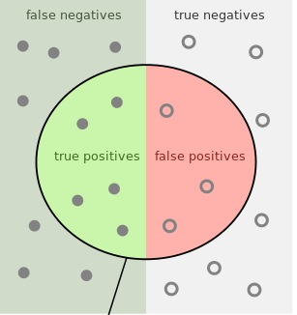
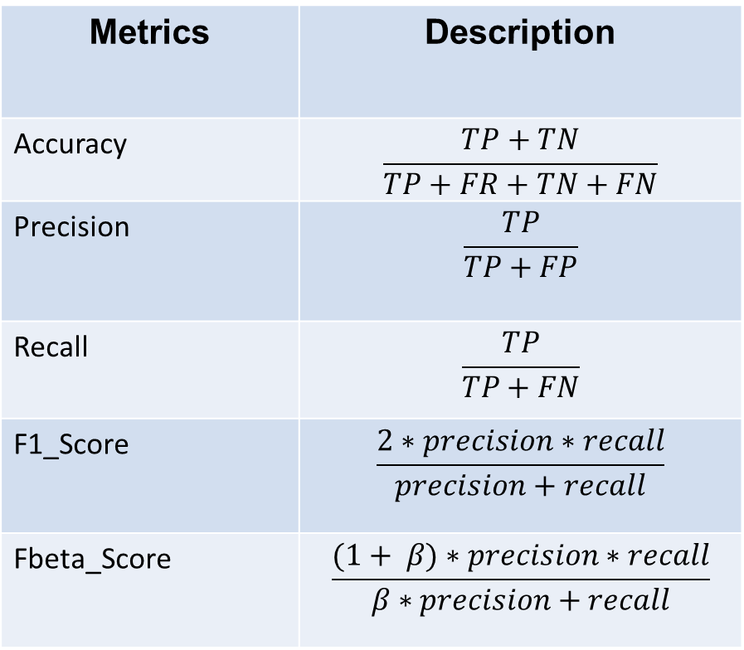
Metrics for the classification problem
Metrics | Description
Accuracy | $$\frac{TP+TN}{TP+FR+TN+FN}$$
Precision | $$\frac{TP}{TP+FP}$$
Recall | $$\frac{TP}{TP+FN}$$
F1_Score | $$\frac{2∗precision∗recall}{precision+recall}$$
Fbeta_Score | $$\frac{(1+ β)∗precision∗recall}{β∗precision+recall}$$
metric = { "class":Accuracy, "metric_args":{ "threshold": 0.5, "from_logits":True } }

Slide 8
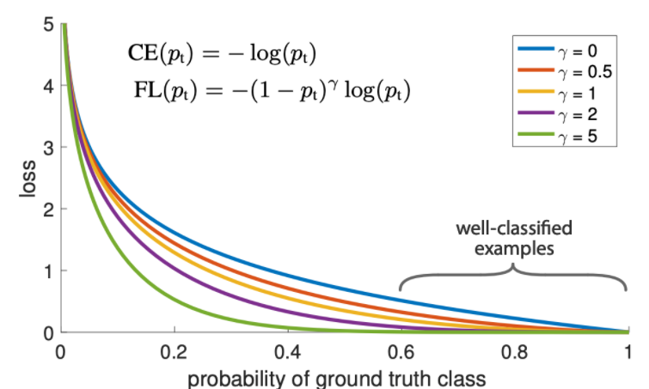
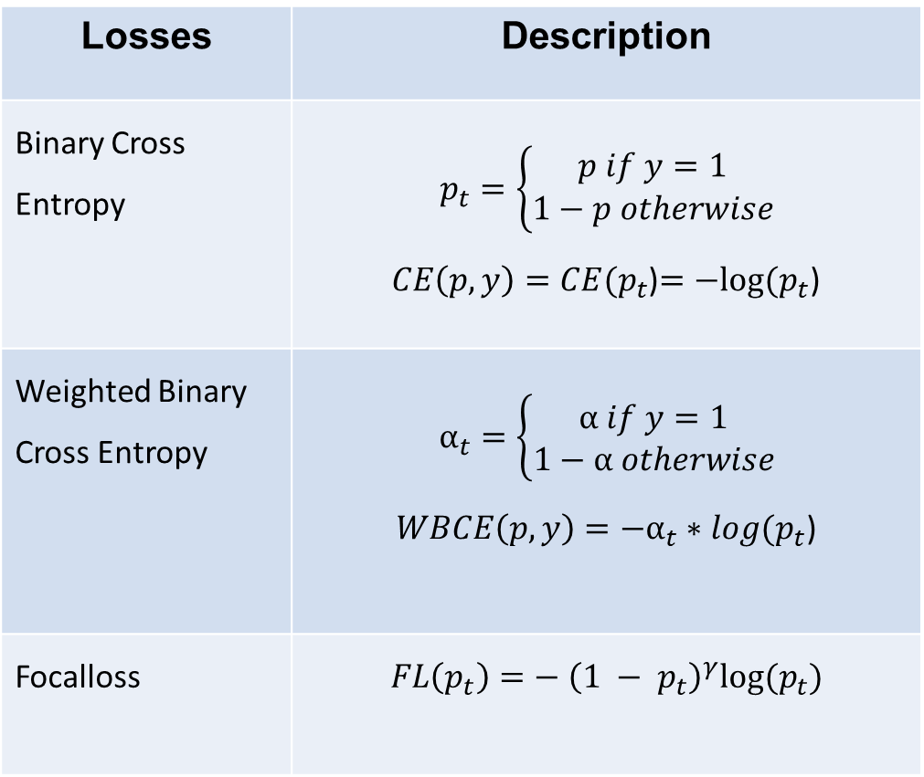
Loss function for the classification problem
Losses | Description
Binary Cross Entropy | $$p_{t}=\left\{\begin{aligned}p if y=1 \\ 1−p otherwise\end{aligned}\right.$$ $CE\left(p, y\right)=CE(p_{t}$)$=−log⁡(p_{t}$)
Weighted Binary Cross Entropy | $$α_{t}=\left\{\begin{aligned}α if y=1 \\ 1−α otherwise\end{aligned}\right.$$ $WBCE\left(p, y\right)=−α_{t}∗log⁡(p_{t}$)
Focalloss | $$FL\left(p_{t}\right)=− {\left({1 − p}_{t}\right)}^{γ}log⁡(p_{t})$$
loss_function = { "class": nn.BCEWithLogitsLoss, "loss_args":{ } }

Slide 9
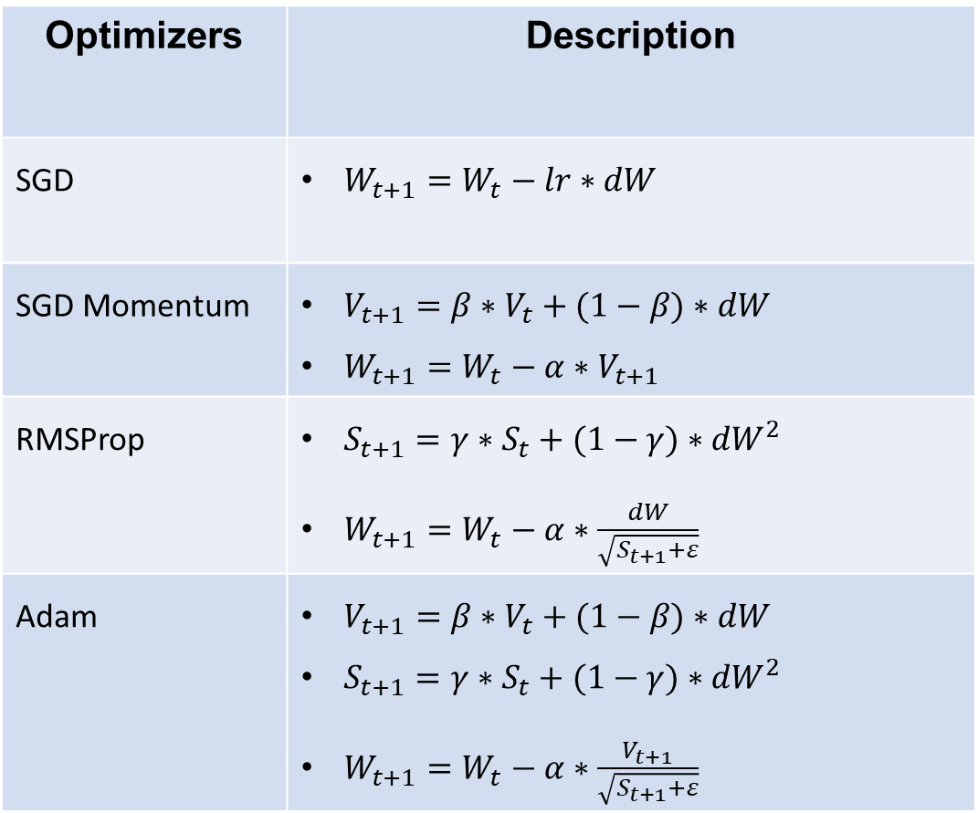
Optimizers for the classification problem
Optimizers | Description
SGD | $W_{t+1}=W_{t}−lr∗dW$
SGD Momentum | $V_{t+1}=β∗V_{t}+(1−β)∗dW$ $W_{t+1}=W_{t}−α∗V_{t+1}$
RMSProp | $S_{t+1}=γ∗S_{t}+(1−γ)∗{dW}^{2}$ $W_{t+1}=W_{t}−α∗\frac{dW}{\sqrt{S_{t+1}+ε}}$
Adam | $V_{t+1}=β∗V_{t}+(1−β)∗dW$ $S_{t+1}=γ∗S_{t}+(1−γ)∗{dW}^{2}$ $W_{t+1}=W_{t}−α∗\frac{V_{t+1}}{\sqrt{S_{t+1}+ε}}$
from torch.optim import SGD optimizer ={ "class": SGD, "optimizer_args":{ "momentum":0.9 } }

Slide 10
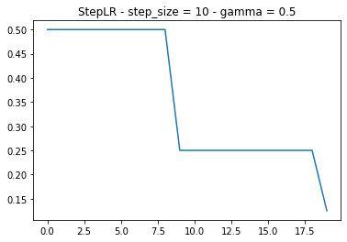
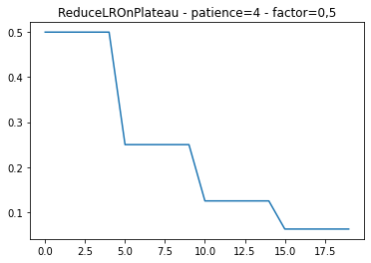
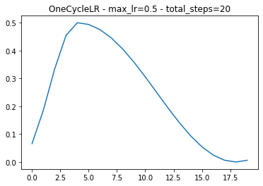
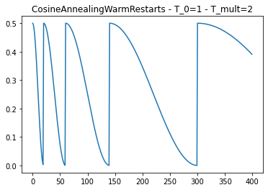
Learning rate scheduler

Slide 11
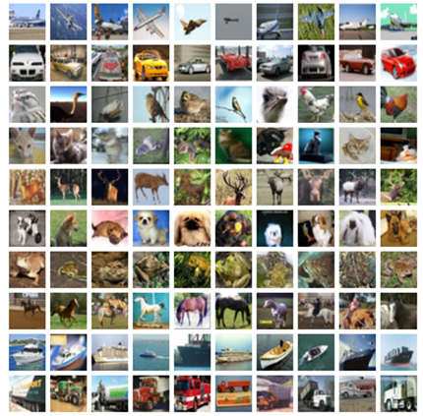
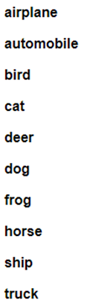
Experiments
Cifar10 dataset

Slide 12


Experiments
MenWoman dataset
Men
Woman

Slide 13
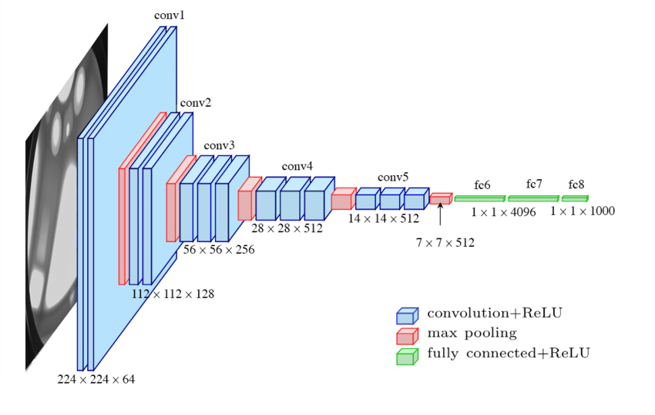
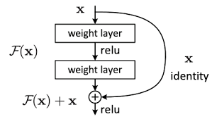
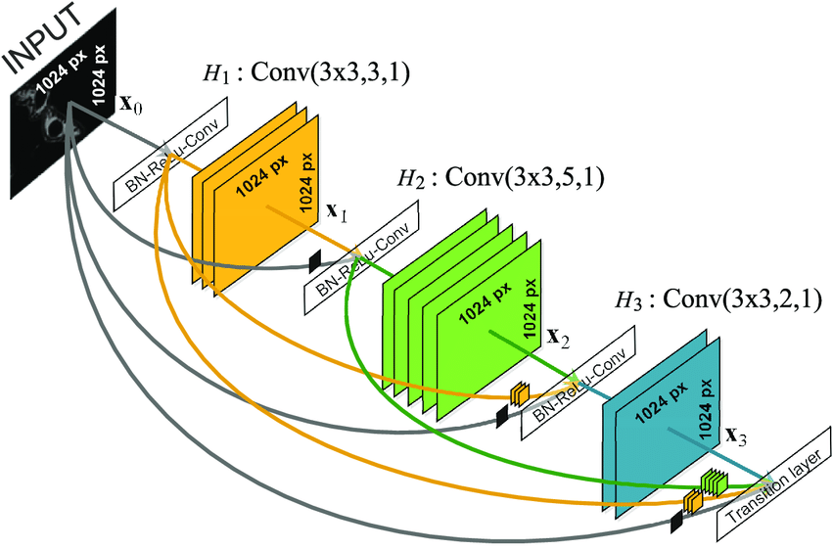
Experiments with different models
Configs - Dataset: Cifar10 - CrossEntropy loss - SGD Optimizer - LRStep (1e-3) | Models | Parameters | Accuracy
 | CNN | 62,006 | 0.49
 | Resnet18 | 11,181,642 | 0.77
 | Resnet18-pretrained | 11,181,642 | 0.82
 | VGG16-pretrained | 134,301,514 | 0.88
 | Resnet50-pretrained | 25,567,042 | 0.85
 | Densenet121-pretrained | 6,964,106 | 0.82
Observation:
Using pretrained models has better result
Deeper networks is better
Residual blocks and dense blocks improve result with small parameters

Slide 14
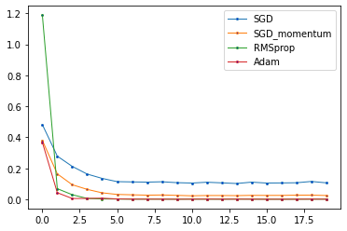
Experiments with different optimizers
Configs MenWoman dataset Densenet121 BCE loss Lr: 1e-4 StepLR Scheduler Epochs: 20 Batchsize:64 | Optimizers | Accuracy
 | SGD | 0.9012
 | SGD Momentum | 0.9273
 | RMSProp | 0.9351
 | Adam | 0.9505

Slide 15
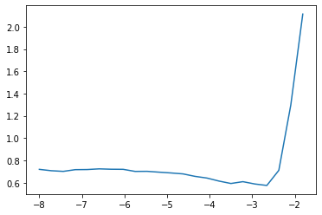
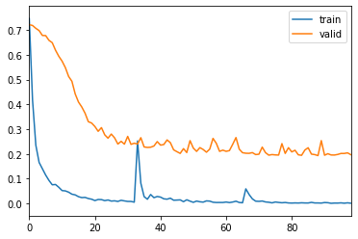
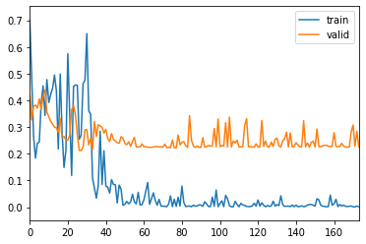
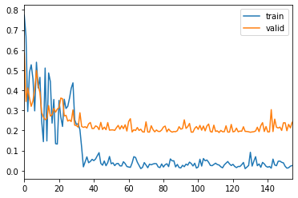
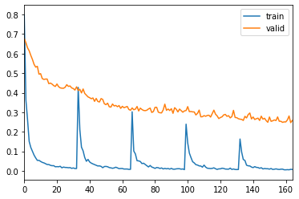
Experiments with different lr-scheduler
Config: MenWomen Densenet121 Adam optimizer BCE Loss Img_size: 256 Batch_size: 16 - LR: 1e-4 | Lr-schedulers | Accuracy
 | StepLR | 0.9169
 | ReduceLROnPlateau | 0.9273
 | OneCycle | 0.9325
 | CosineAnnealingWarmStart | 0.9351
OneCycle
ReduceLROnPlateau
StepLR
CosineAnnealingWarmStart

Slide 16
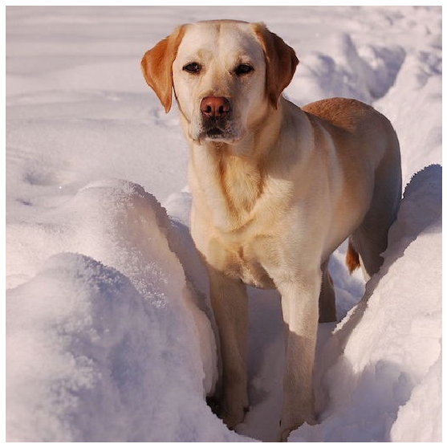
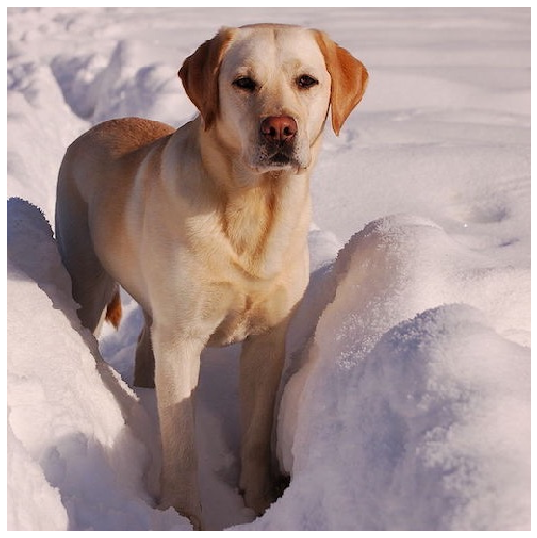
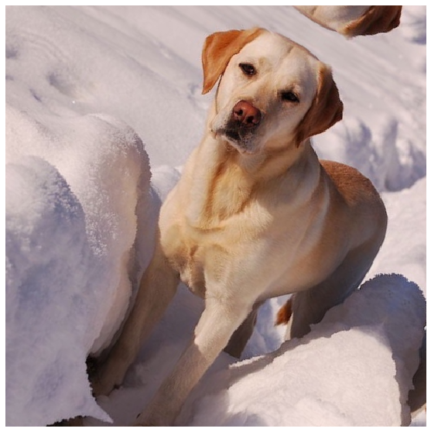
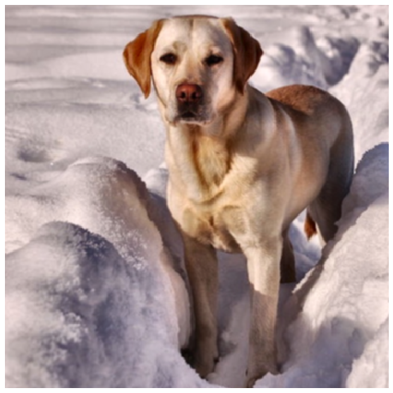
Experiments with augmentation
original
flip
rotate
Brightness - Contrast
Config: MenWomen Densenet121 Adam optimizer BCE Loss Img_size: 256 Batch_size: 16 - LR: 1e-4 | Augmentation | 0.9169
 | No agumentation | 0.9171

Slide 17
Summary
Build Training pipeline
Learn and experiments with differents:
Models
Optimizer
Loss
Metrics
Augmentation

Slide 18
Future plan
Investigate to Segmentation problem (2D, 3D)
Investigate to SOTA network(Unet, HRnet, …)
Post processing (CRF, ..)
…

Slide 19
Thanks for watching

